Slide 1
Neural Networks – Layout, traning, usage

Slide 2
Outline
Goal: Understand the layout, training process & usages of NN’s
Go through the process of construction
Universal function approximator → Neural Network
How does it know what to do? → Training process
Backpropagation
Difficulties/issues
Overfitting? Model size? Reproducibility etc…

Slide 3
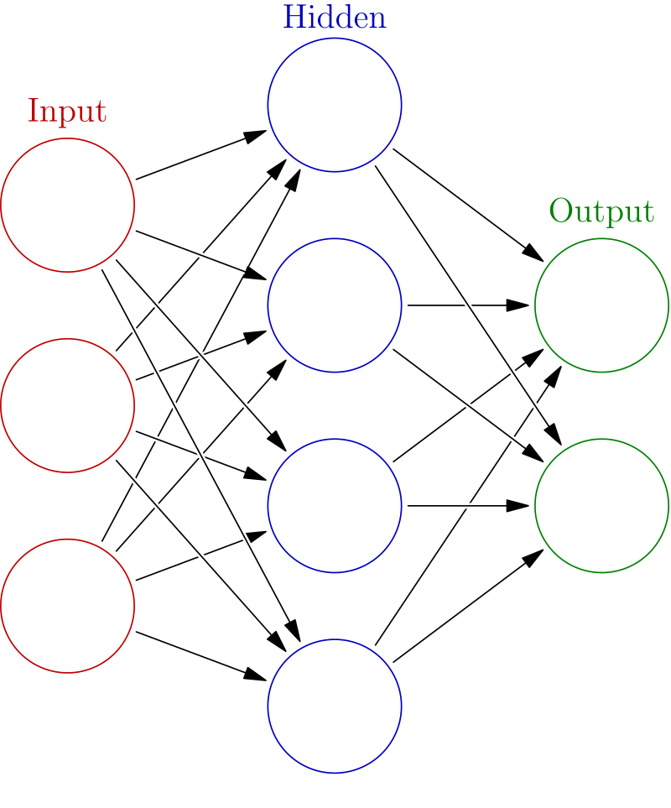
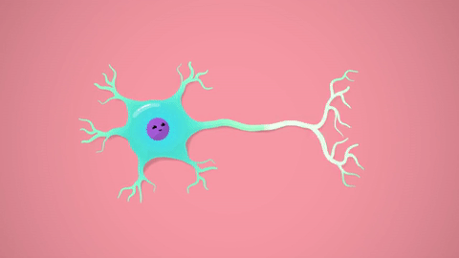
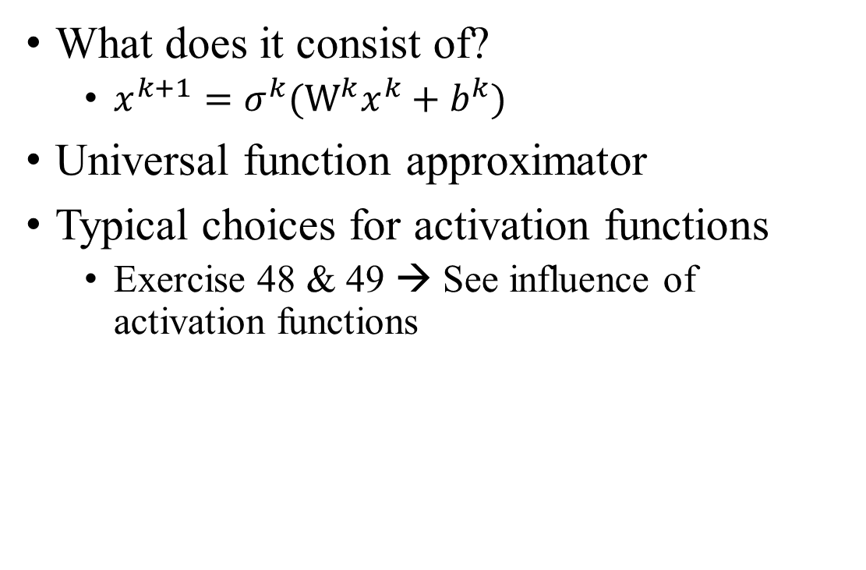
Layout of Neural Networks
What does it consist of?
$x^{k+1}=σ^{k}(W^{k}x^{k}+b^{k})$
Universal function approximator
Typical choices for activation functions
Exercise 48 & 49 → See influence of activation functions

Slide 4
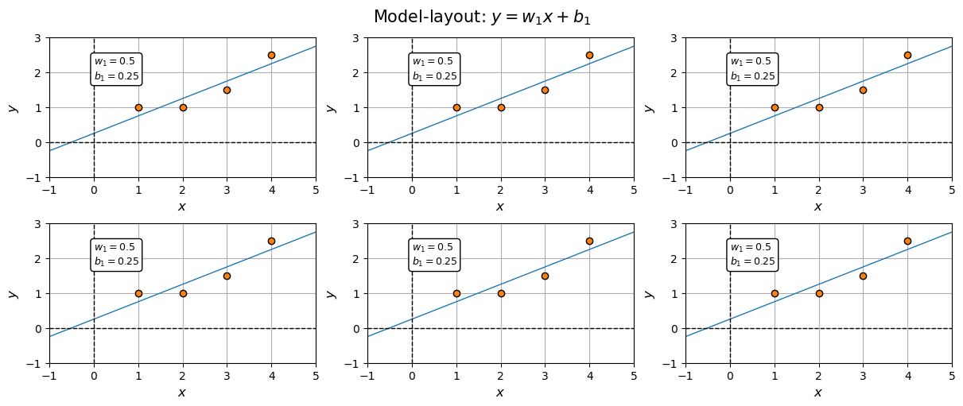
Exercise 48 & 49
Maybe model is too small?

Slide 5
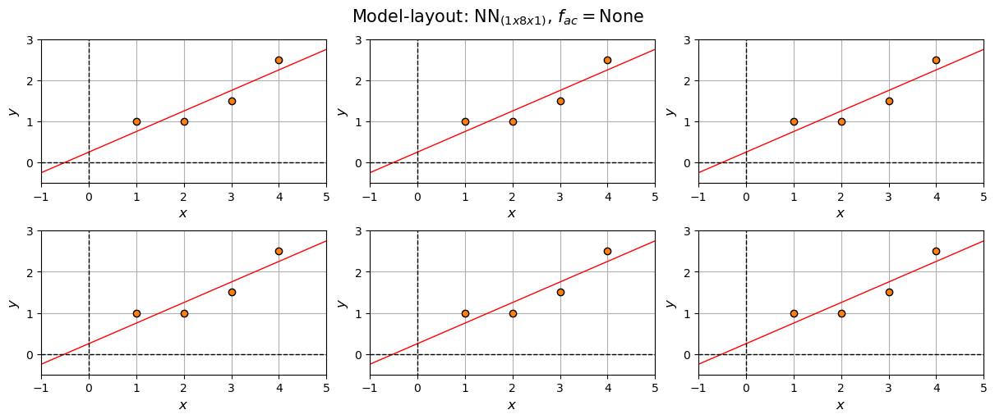
Exercise 48 & 49

Slide 6
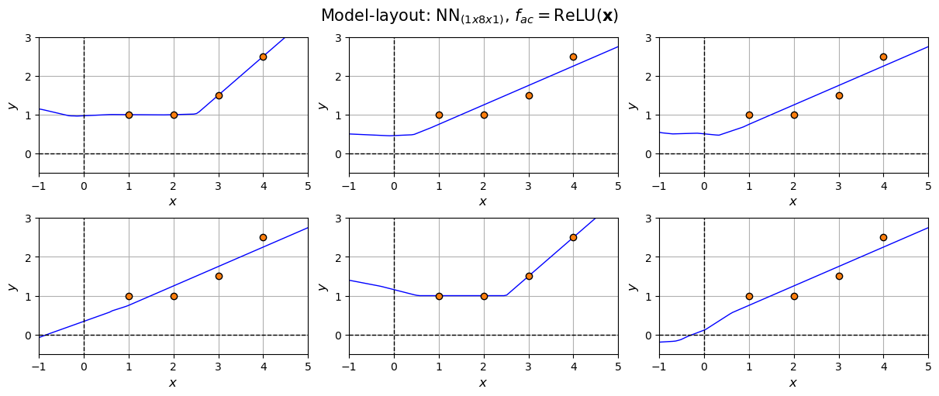
Exercise 48 & 49
Even works for small model

Slide 7
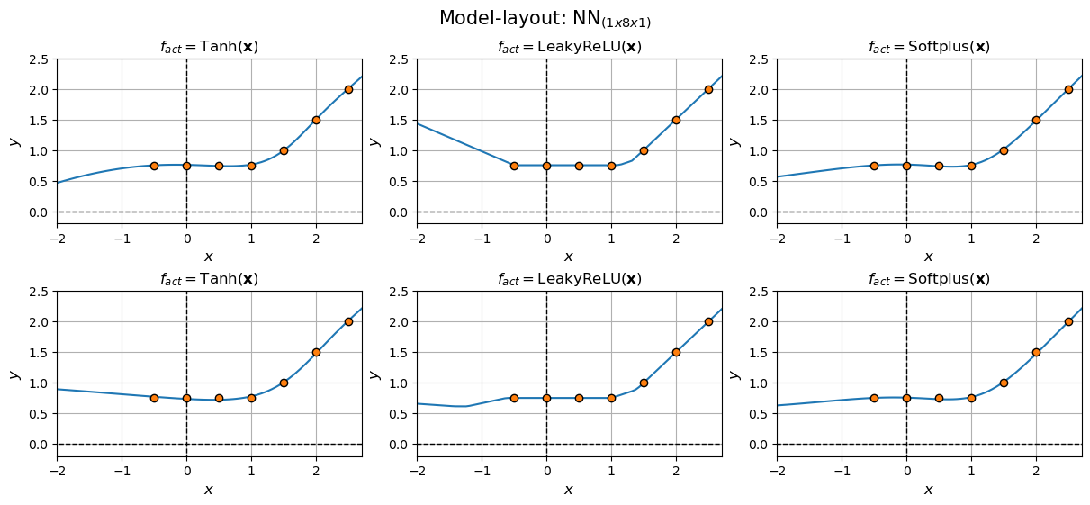
Exercise 48 & 49

Slide 8
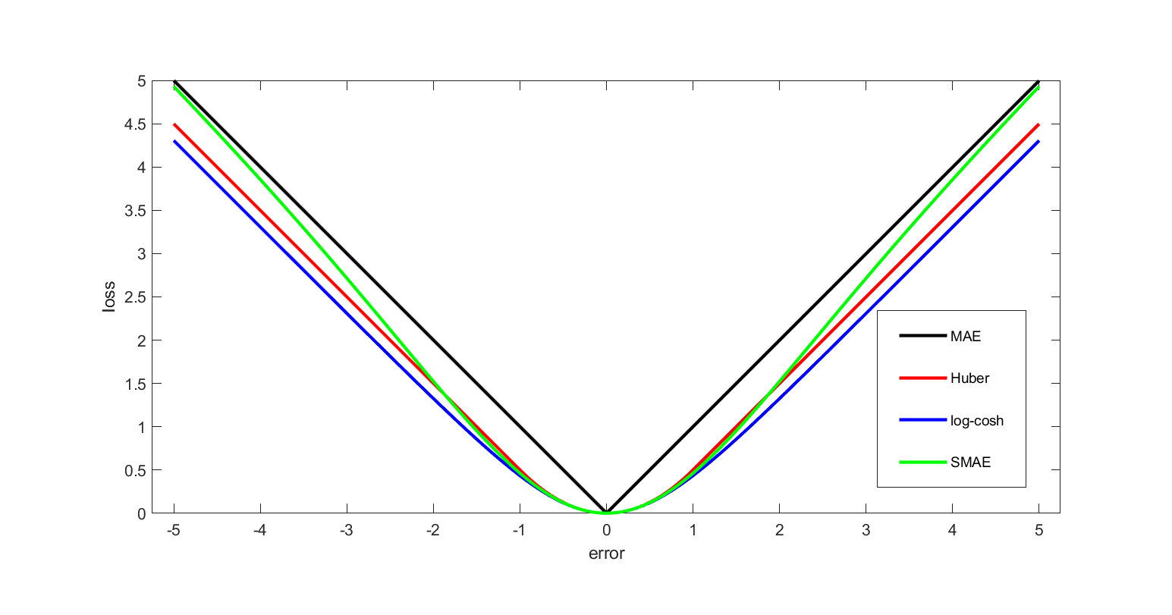
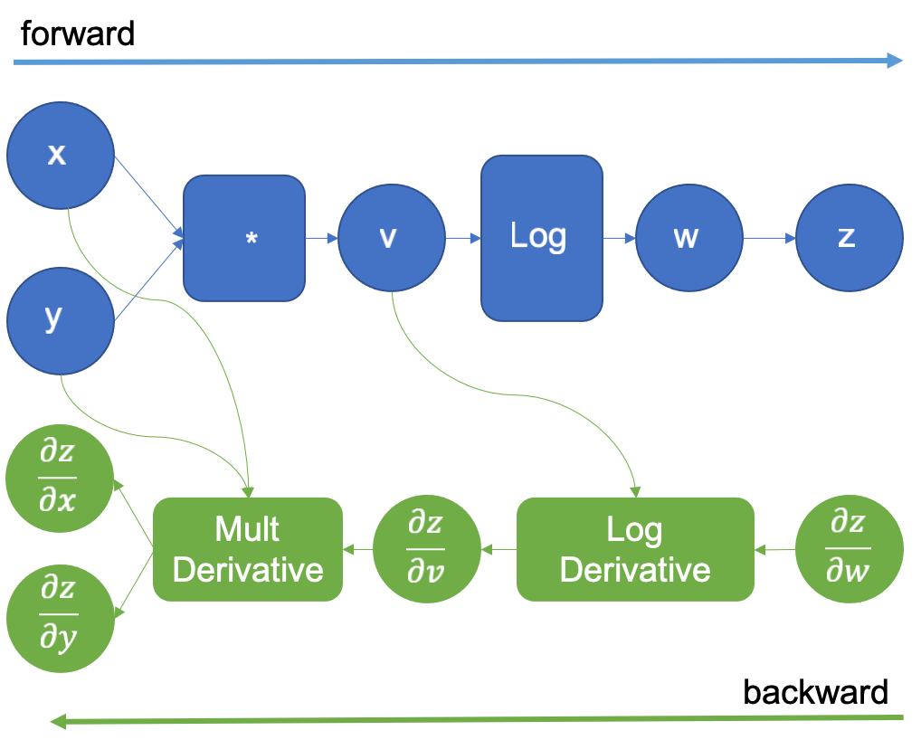
Training
Tune parameters by minimizing loss
MSE, MAE, HuberLoss etc.
Stoch. Gradient descent & Adam
Many parameters → Backpropagation
Chain-rule → Simple functions are known
Impossible without
Let’s go through some examples

Slide 9
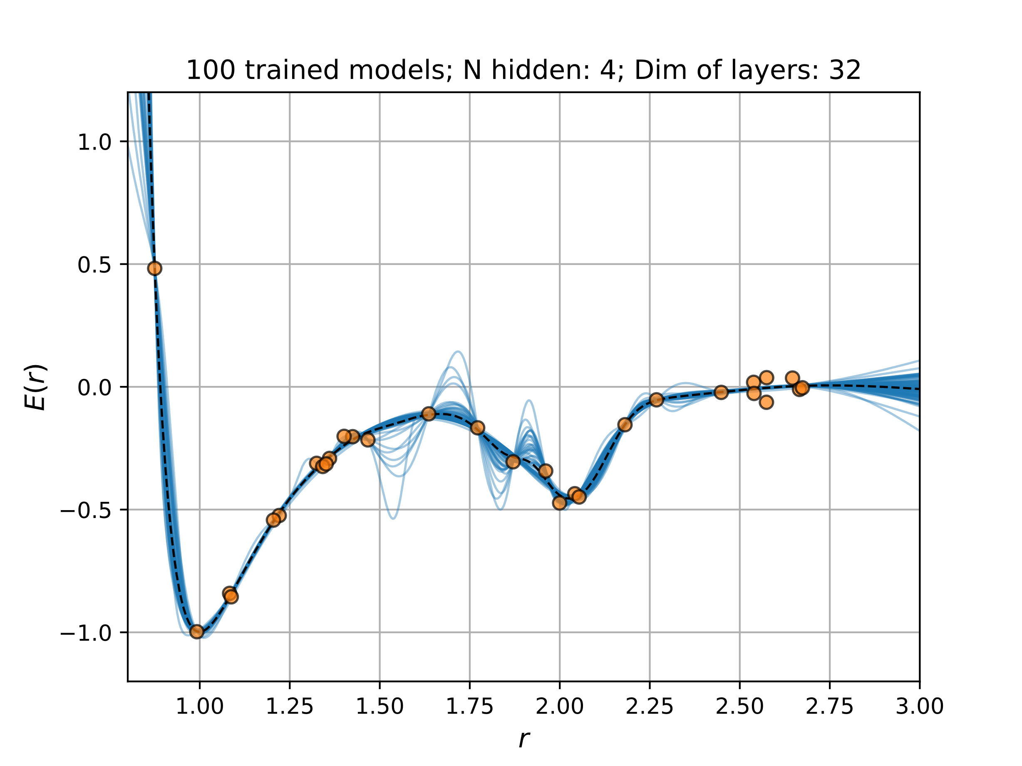
Training
Reproducibility? Uncertainties?
What about overfitting?
Early-stopping, drop-out, regularization
Learning-rate

Slide 10
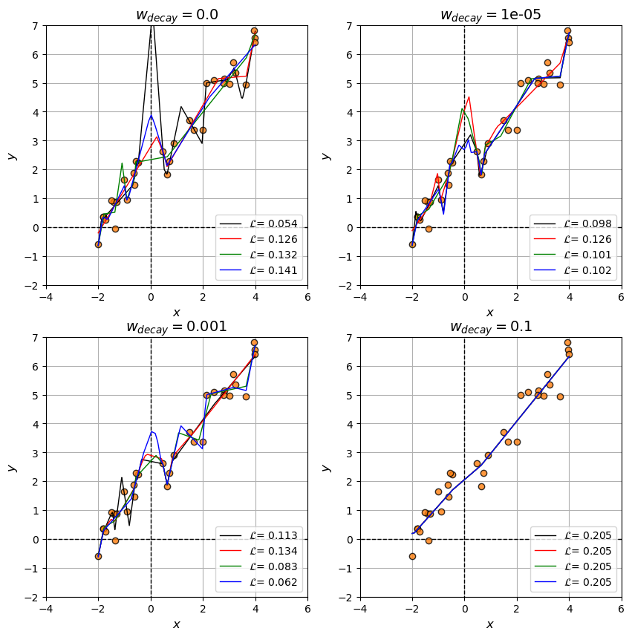
Regularization:
Add penalty term in loss function

Slide 11
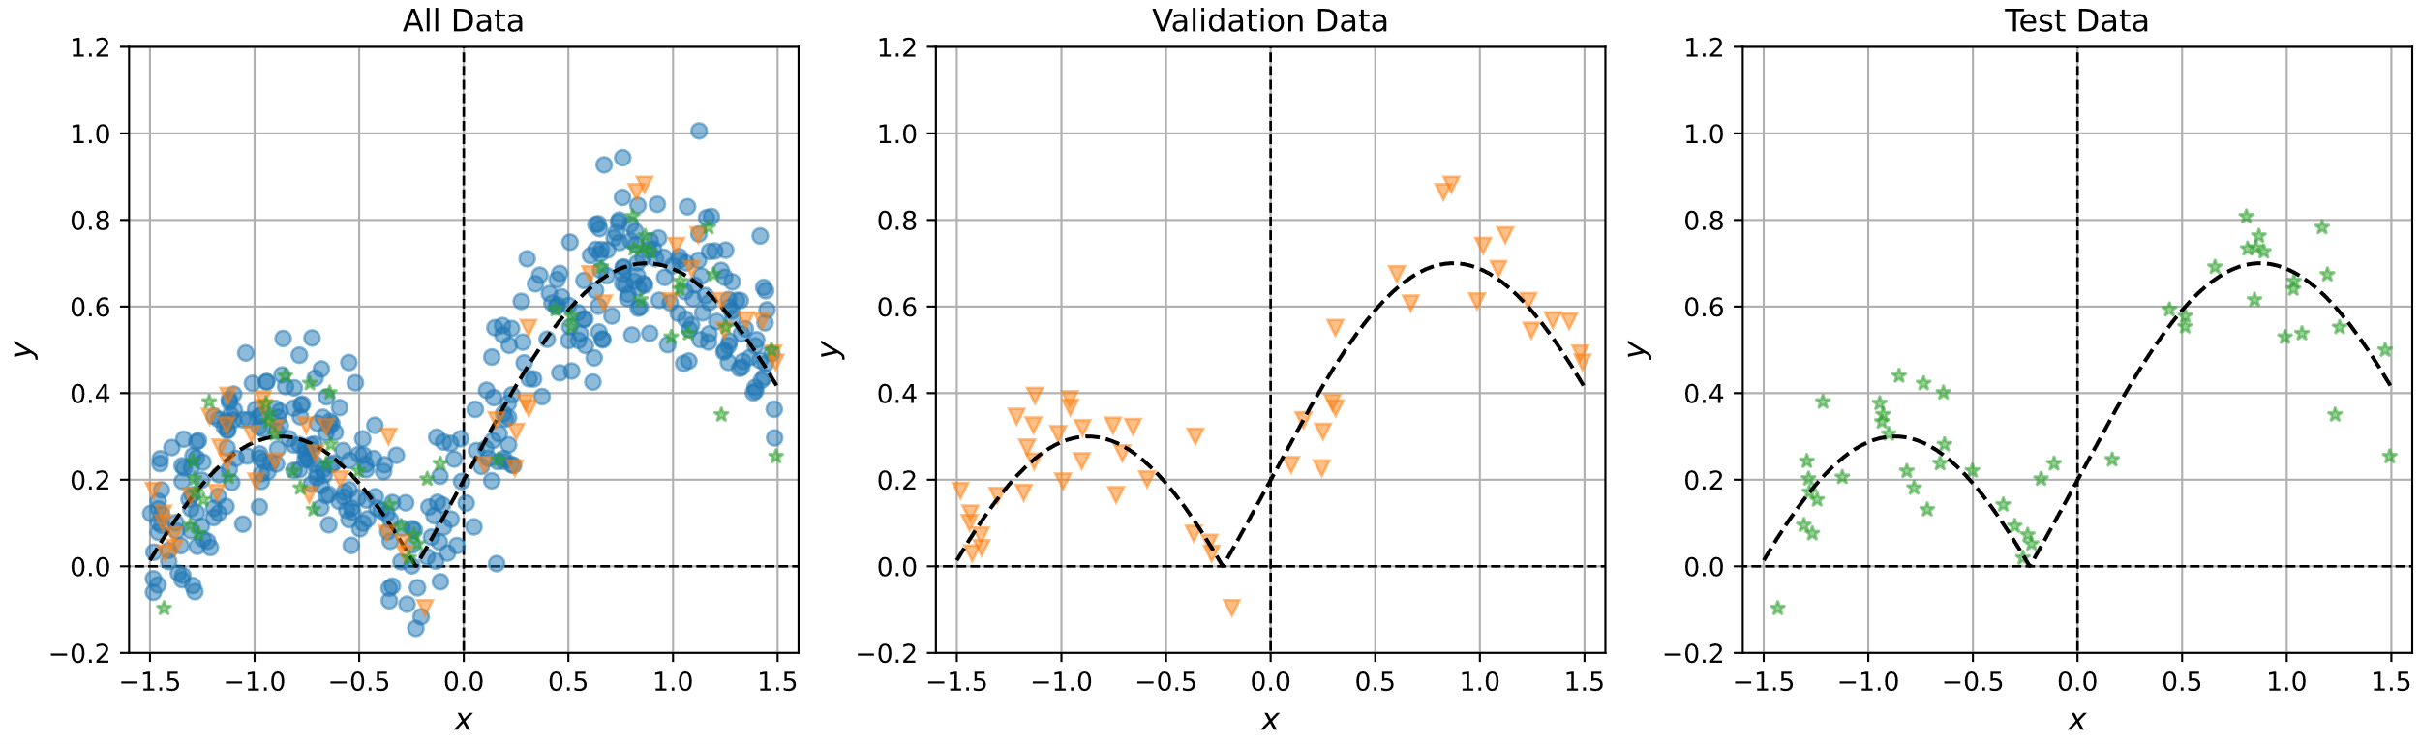
Training – Exercise 53
Another trick → split data & look at learning curves
Influence of batch-sizing and early-stopping

Slide 12
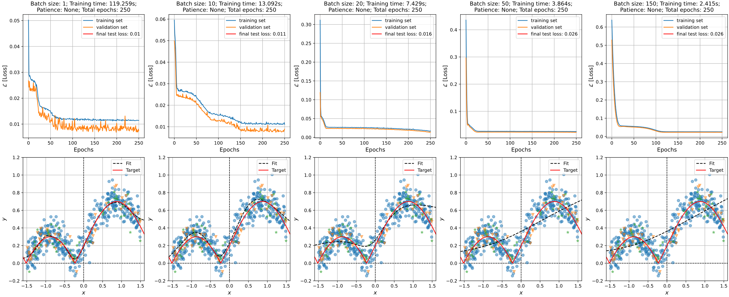
NN’s for regression – Exercise 53

Slide 13
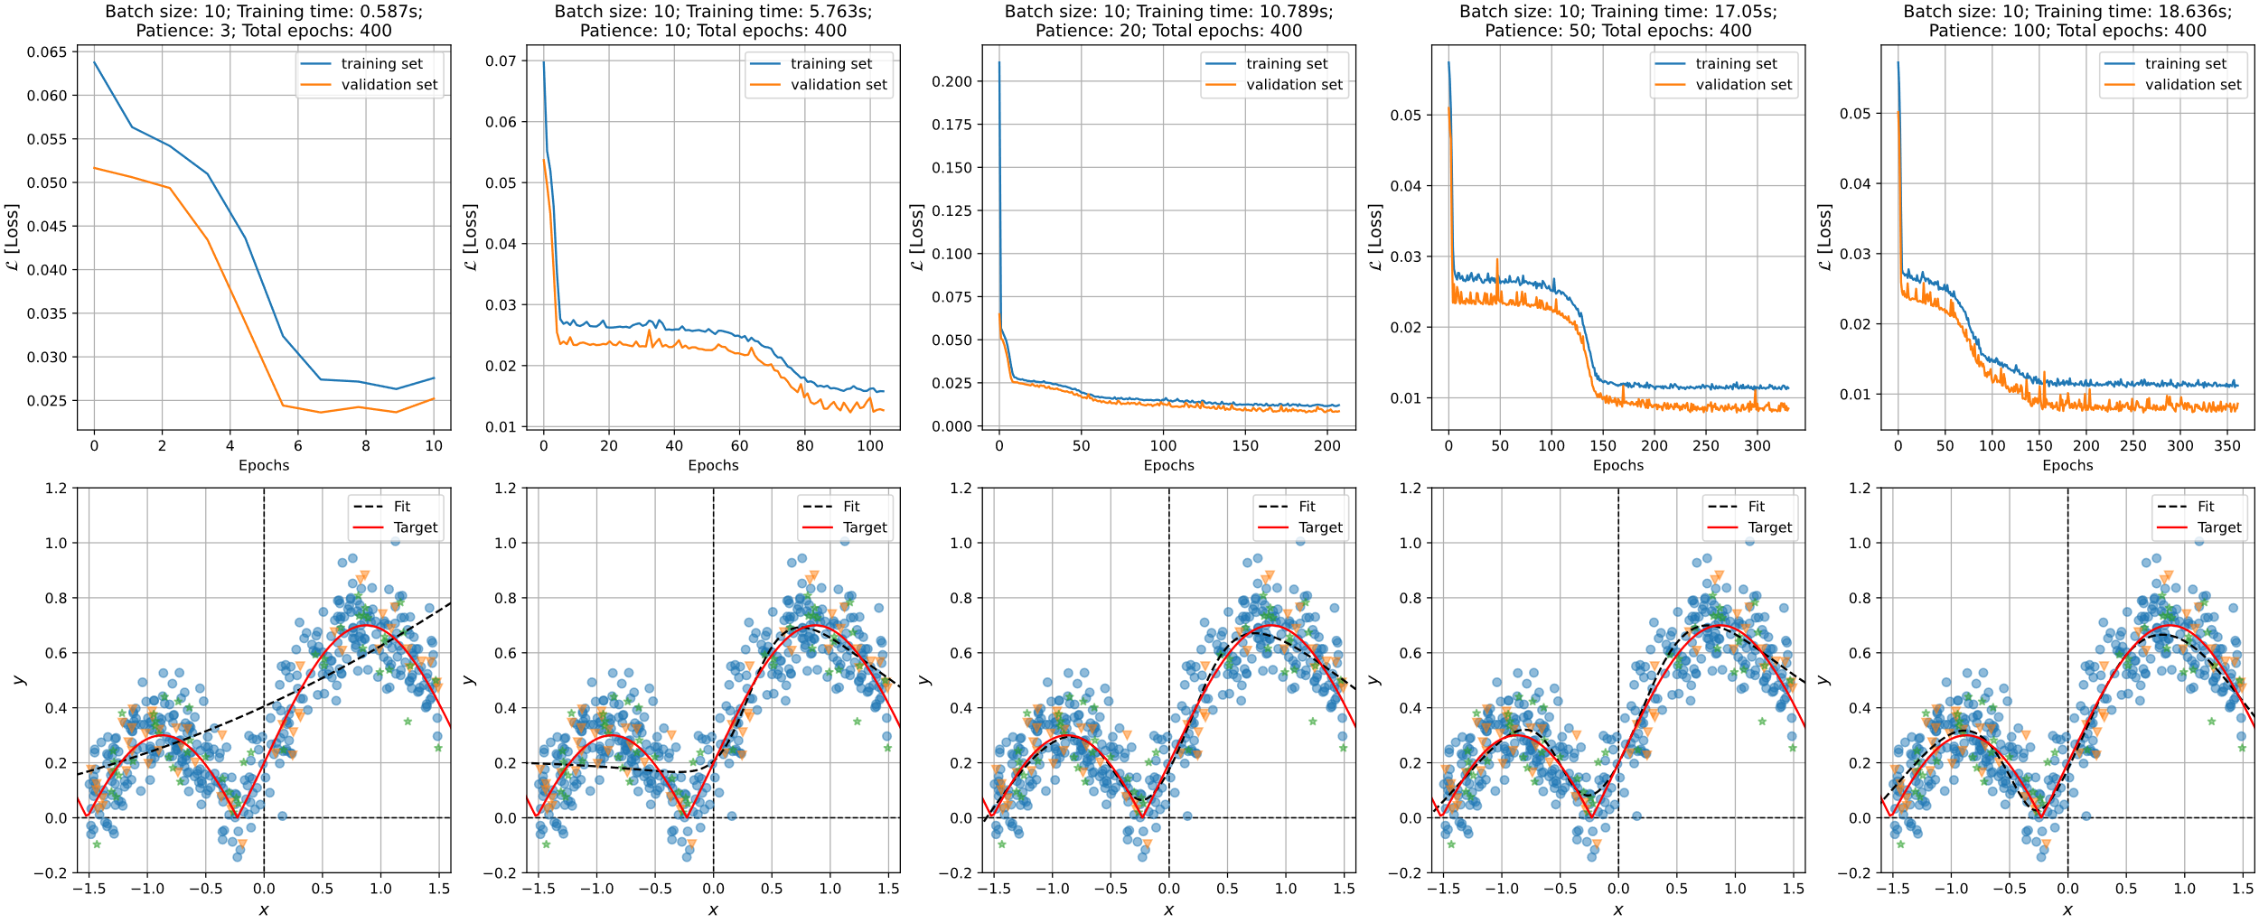
NN’s for regression – Exercise 53

Slide 14
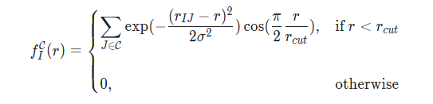
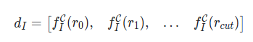
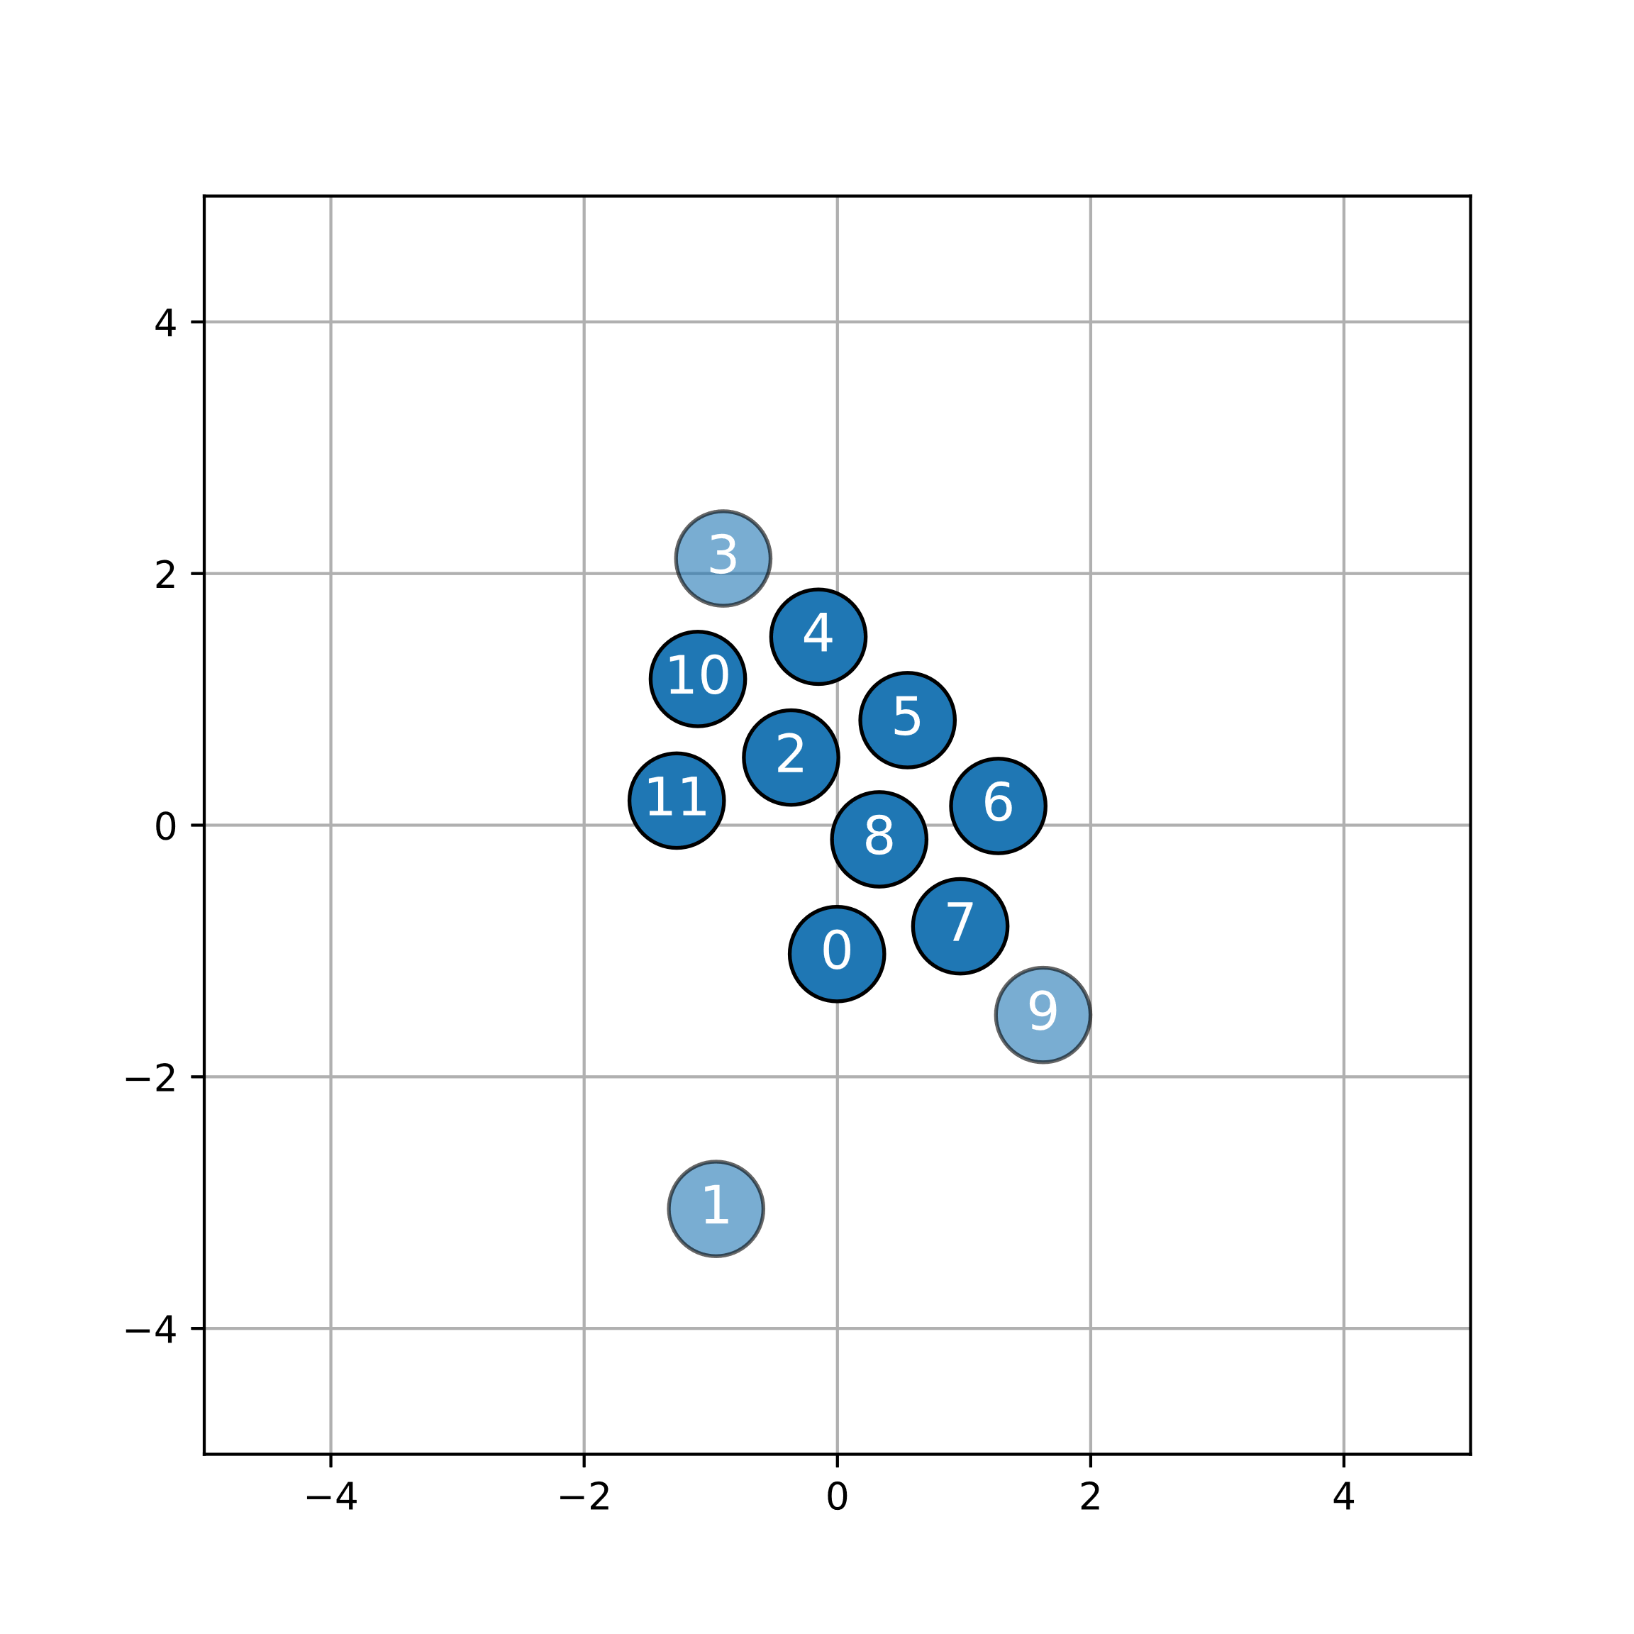
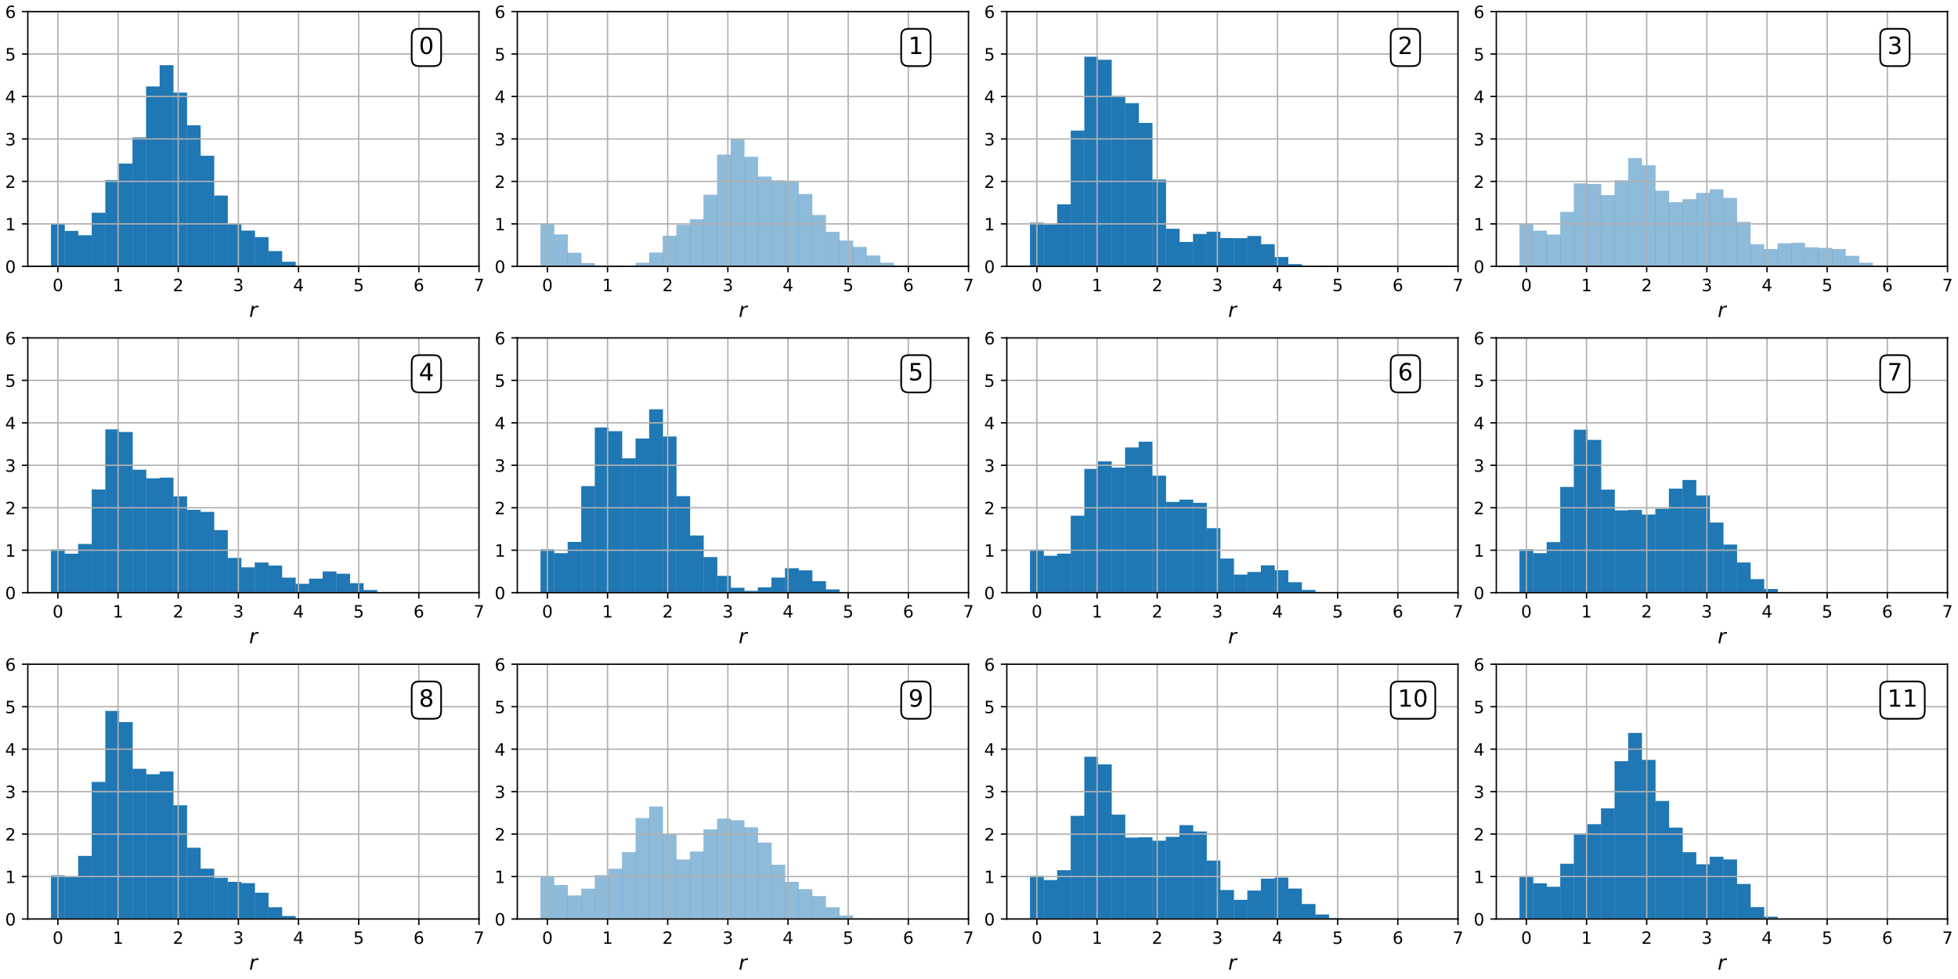
Another example: Exercise 58
New example: Make Neural Network do the classification
Minimize the Cross Entropy
Atomic level descriptor:
Label: ”Positive”
Label: ”Negative”

Slide 15
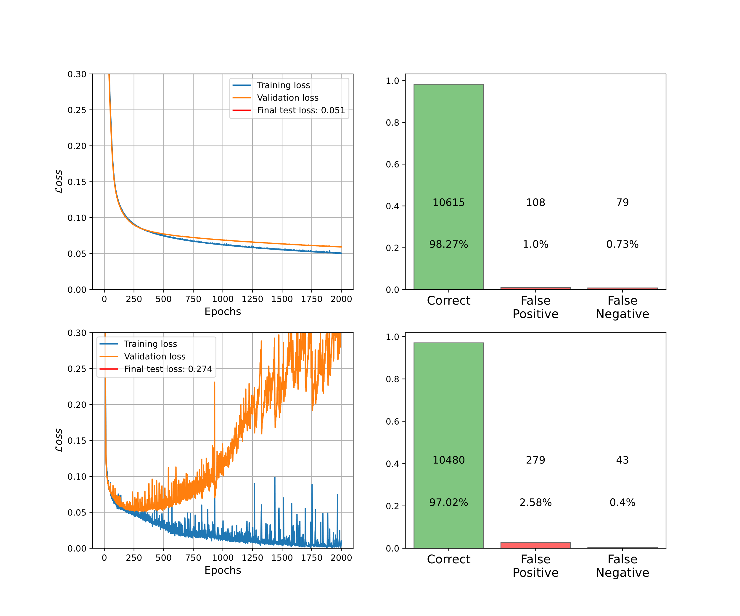
Another example: Exercise 58
Investigate influence of different training parameters
Small training set & no early-stopping
Two NN models trained:
1-model: 1 hidden layer of 3 neurons
2-model: 6 hidden layers of 42 neurons

Slide 16
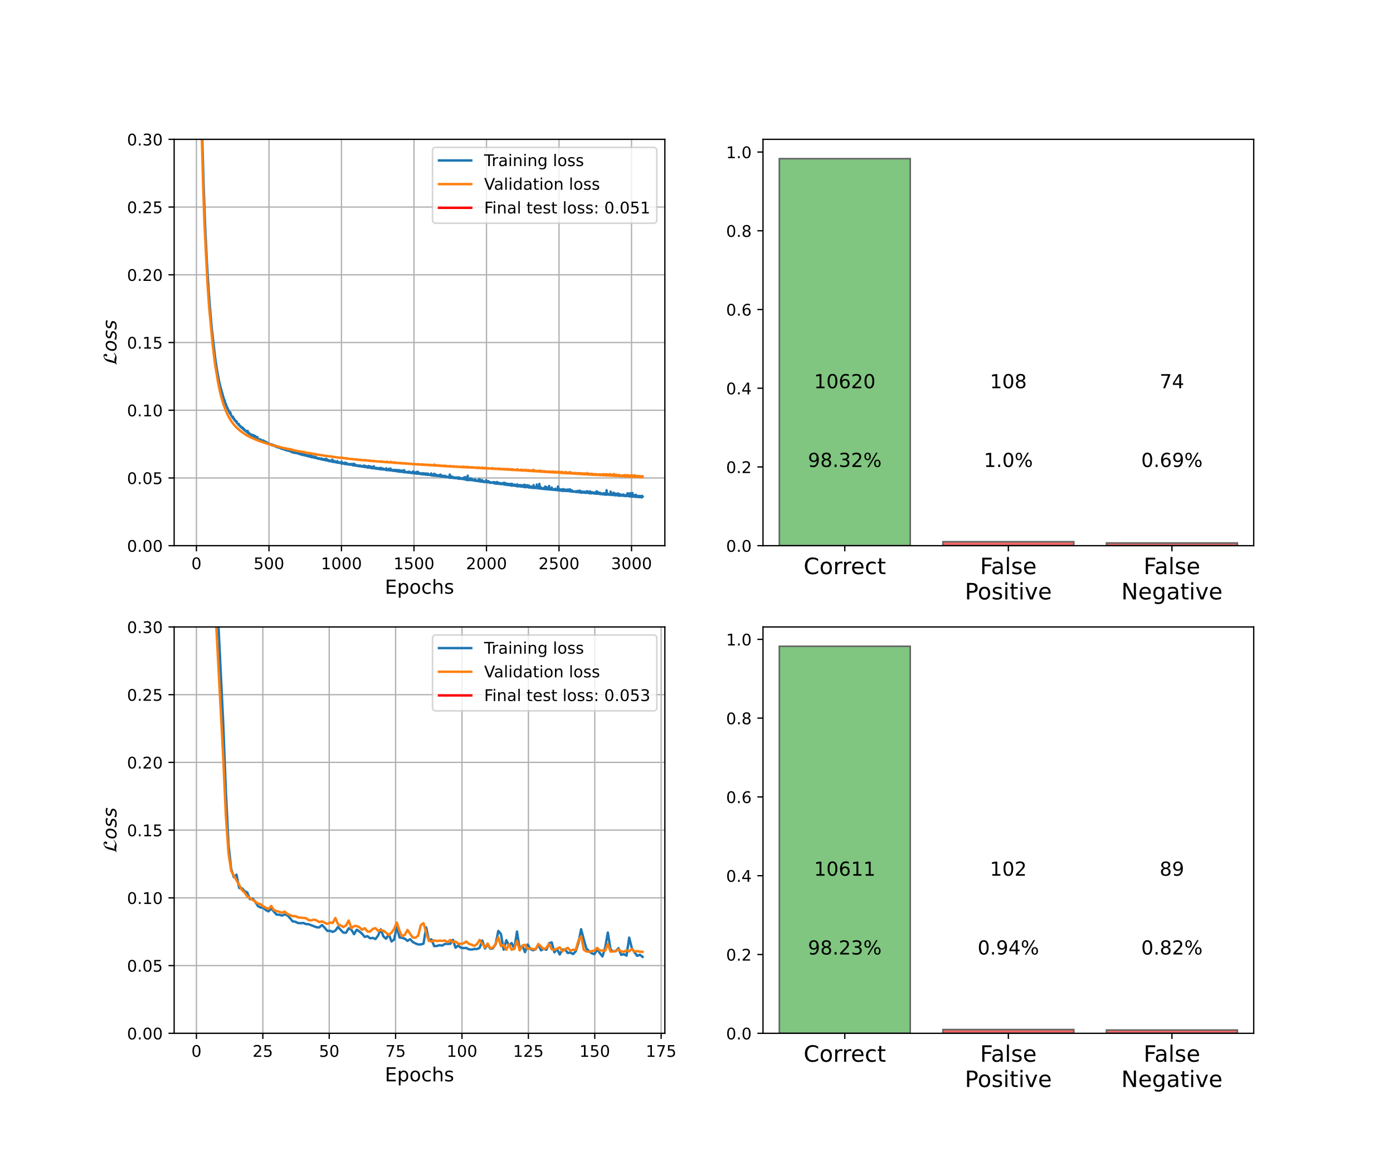
Another example: Exercise 58
Investigate influence of different training parameters
Small training set & with early-stopping
Two NN models trained:
1-model: 1 hidden layer of 3 neurons
2-model: 6 hidden layers of 42 neurons

Slide 17
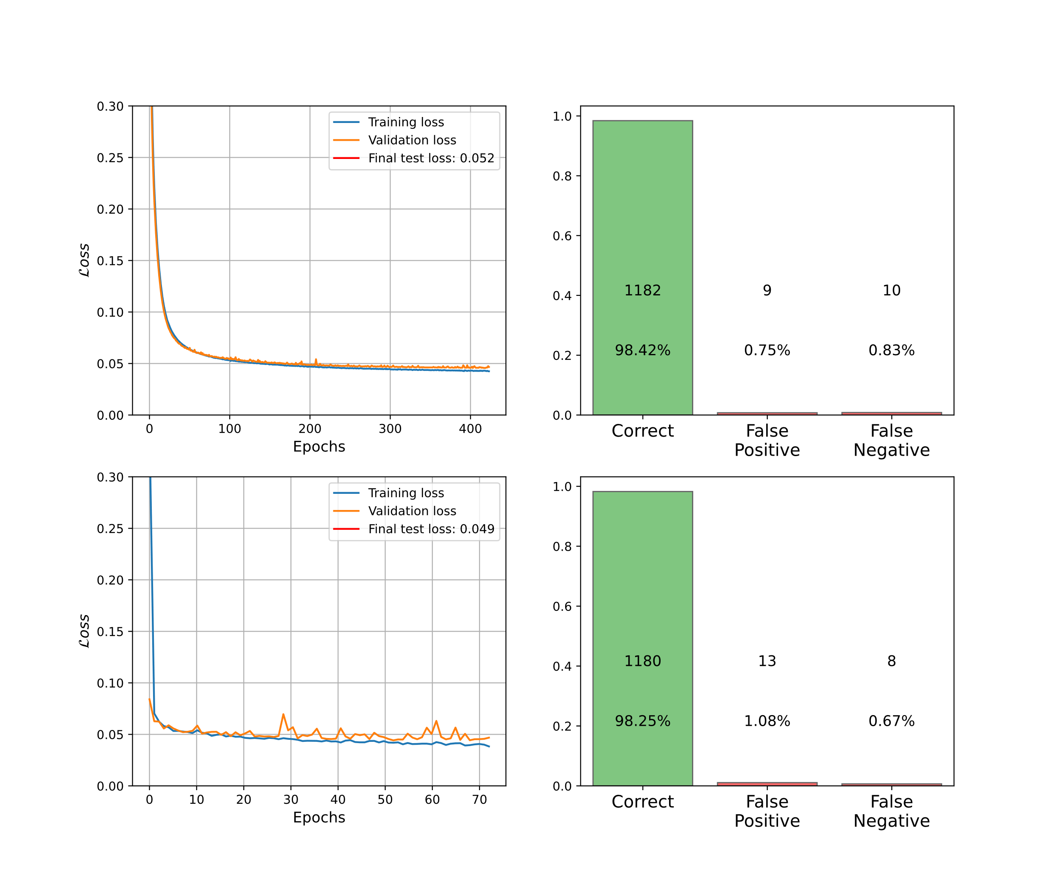
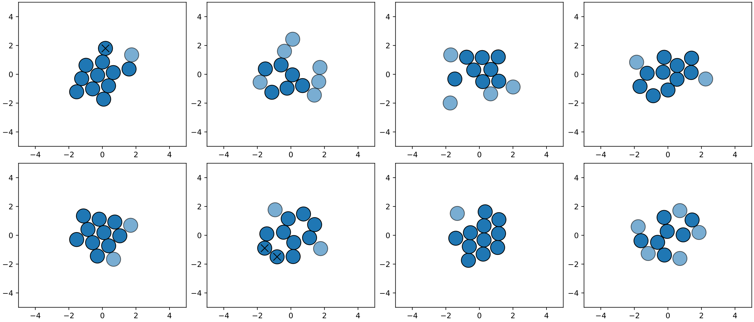
Another example: Exercise 58
Investigate influence of different training parameters
Large training set & with early-stopping
Two NN models trained:
1-model: 1 hidden layer of 3 neurons
2-model: 6 hidden layers of 42 neurons

